Slide 1
Send an e-mail to a company
WRITING STRUCTURE
UNIT 9

Slide 2
FORMAL E-MAIL
In this term we will work on the importance of presenting a good CV and a good Cover Letter to a company. How do we usually contact them to send them our information? Mostly by e-mail. Therefore, we are going to work on the structure of the Formal E-mail in a more specific way as it will be addressed to a specific company.

Slide 3
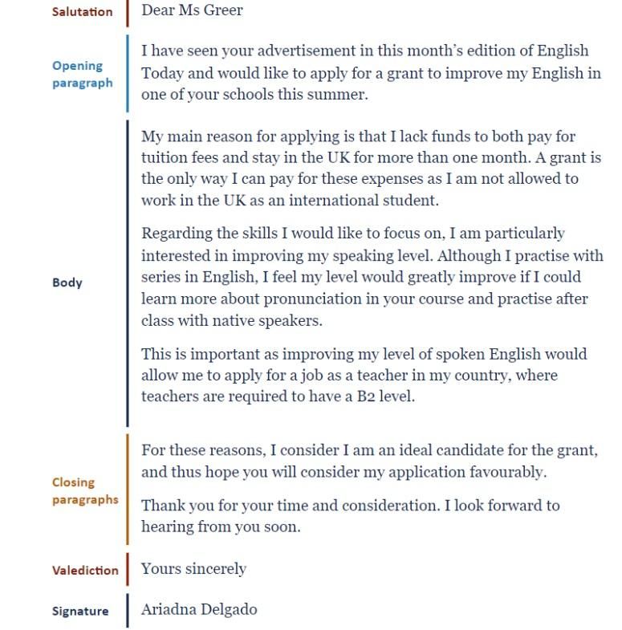
STRUCTURE
After the Greeting and Valediction you must always put a comma.
Paragraph separation is essential
Formal speech
GREETING: Si el enunciado te deja claro el destinatario: Dear Madam López/ Dear Mr. Martínez (no le llamamos por su nombre y en el caso de las mujeres nunca utilices Mrs o Miss) si no sabemos su nombre escribimos: Dear Sir o Madam o To whom it may concern (A quien corresponda).
Si no aparece el destinatario porque es una empresa, no pongas DEAR AMAZON, por ejemplo, To the attention of the department of ... en el caso que sea para una carta de presentación (Application letter) o una reclamación (letter of complaint).
CAPITAL LETTERS
NO TITLES!

Slide 4
TIPS & SUPPORT
8 Email Etiquette Tips - How to Write Better Emails at Work:
https://www.youtube.com/watch?v=1XctnF7C74s
30 Phrases for the Perfect Business Email:
https://www.youtube.com/watch?v=Sw61Uu8ftII

